Slide 1
TRANSACTIONAL RISK INSURANCE
USING TRANSACTIONAL RISK SOLUTIONS TO CLOSE THE DEAL

Slide 2
Agenda
Transactional Risk Insurance Overview
Representations & Warranties Insurance
Tax Indemnity Insurance
Contingent Liability Insurance
Appendix A – Contact Information and Biographies

Slide 3
TRANSACTIONAL RISK INSURANCE OVERVIEW

Slide 4
Transactional Risk Insurance Overview
Created to facilitate M&A transactions by addressing indemnification issues that arise during the negotiation of the transaction or during due diligence that may prevent the deal from signing:
  Representations and warranties insurance
  Tax indemnity insurance
  Contingent liability insurance
Transactional risk insurance is used to protect or mitigate two types of risks that typically arise from M&A transactions:
Unknown and
unforeseen loss
Representations and warranties insurance
Buyer-side policy
Seller-side policy
Identified and
known risks
Identified tax issues
Other contingent risks (e.g., successor liability)

Slide 5
Transactional Risk Insurance Overview
Significant growth in North America during last five years
  2018
    $13.75 billion in limits / 405 closed deals
  2017
  $8.83 billion in limits / 303 closed deals
  2016
  $6.03 billion in limits / 212 closed deals
  2015
  $4.26 billion in limits / 159 closed deals
  2014
  $2.73 billion in limits / 130 closed deals
  2013
    $1.34 billion in limits / 66 closed deals
  2012
    $1.43 billion in limits / 51 closed deals
  2011
    $767 million in limits / 45 closed deals
  2010
    $387 million in limits / 25 closed deals
North America Market Statistics for Marsh only

Slide 6
Transactional Risk Insurance Overview
The transactional risk insurance market has continued to evolve in recent years and can provide more innovative insurance solutions than ever
The market now offers:
  Broader coverage
  Streamlined process
  Increased limits of liability
  Reduced premium rates and deductible levels
Marsh has an estimated 25% global market share
Marsh placed over 1,100 Transactional Risk policies globally in 2018
Global Market Statistics for 2018 (Marsh only)
US$ | AMERICAS | EMEA | ASIA PACIFIC | TOTAL
Limits of insurance placed ($) | 13,755,000,000 | 10,566,000,000 | 3,575,000,000 | 27,897,000,000
No. of closed transactions | 405 | 285 | 99 | 789
Private equity policies (as % of policies placed) | 55% | 57% | 52% | 54%
Corporate policies (as % of policies placed) | 45% | 43% | 48% | 46%
Seller-side R&W policies (as % of R&W policies placed) | 1% | 2% | 3% | 2%
Buyer-side R&W policies (as % of R&W policies placed) | 99% | 98% | 97% | 98%

Slide 7
REPRESENTATIONS & WARRANTIES INSURANCE

Slide 8
Reps & Warranties Insurance Overview
Provides coverage for financial losses resulting from breaches of representations and warranties made by target company or sellers contained in purchase agreement
Protects an insured from unanticipated (unknown) losses that may arise subsequent to the closing
Reps & warranties insurance generally covers all reps & warranties in the purchase agreement
Either buyer or seller can be the insured under the policy
Reps & Warranties Insurance: Typical Uses
Buyers | Sellers
Increase maximum indemnity / extend survival period for breaches of reps & warranties Provide recourse when no seller indemnity possible Distinguish bid in auction Protect key relationships Elimination of seller post-closing credit risk | Reduce contingent liabilities enabling distribution of sale proceeds Include R&W insurance as the sole remedy in draft agreements in auctions Attract best offers by maximizing indemnification Protect passive sellers
Notes:
_________________________________________________________
_________________________________________________________
_________________________________________________________
_________________________________________________________
_________________________________________________________
_________________________________________________________
_________________________________________________________
_________________________________________________________

Slide 9
Reps & Warranties Insurance: Policy Considerations
Duration of Policy
Policies generally survive for longer periods than in the underlying acquisition agreement
Cost and Coverage Limits
Total costs are typically 3% to 4% of the policy limit (one-time payment) and insureds are able to purchase coverage in excess of amount available via traditional indemnity
Retention / Deductible
Retentions on R&W policies are typically 1% of enterprise value (lower for large deals) and normally drop down to 0.5% of enterprise value at 12-month anniversary of Closing
Definition of Loss
Carriers are typically willing to be silent with respect to consequential and multiplied damages (as opposed to having exclusions for those types of damages)
Materiality Scrape
Carriers are typically willing to recognize materiality scrapes for purposes of determining the existence of a breach of a rep and losses related thereto
Exclusions
Policies contain “Actual Knowledge” exclusion and exclusions for forward looking statements, working capital adjustments, asbestos and PCBs, and pension underfunding/withdrawal, NOL’s/deferred tax assets and transfer pricing
Notes:
_________________________________________________________
_________________________________________________________
_________________________________________________________
_________________________________________________________
_________________________________________________________
_________________________________________________________
_________________________________________________________
_________________________________________________________

Slide 10
Reps & Warranties Insurance: Policy Considerations
Definition of Knowledge
Generally limited to actual conscious awareness (no constructive or imputed knowledge), with no duty to inquire and the carrier having the burden of proving knowledge
Seller Subrogation
Carriers will waive their subrogation rights against the sellers except in instances of fraud
Other Subrogation
Carriers may agree to limit their subrogation rights against customers and suppliers (e.g., no subrogation against customers or suppliers until losses against such parties exceed a specified threshold amount)
Settlements
For small settlements by the insured and/or settlements by the insured within the retention, carriers may agree to waive their consent rights
Failure to Comply
Policies may contain a safe harbor provision, only permitting the carrier to deny coverage to the extent that the carrier is actually/materially prejudiced by an insured’s failure to comply
Signing vs. Closing
Carriers are typically willing to bind coverage at signing subject to an exclusion from coverage of interim breaches

Slide 11
Reps & Warranties Insurance: Heightened Risk Areas
Certain reps & warranties are more difficult to insure and may be addressed through increased due diligence, additional premium, or exclusions
Cyber security/data privacy
Products Liability
Environmental
Wage and hour laws
Healthcare (Medicare and Medicaid billing)

Slide 12


















Reps & Warranties Insurance: State of the Market
Increased popularity and well-developed market
  1,500+ deals completed annually in North America (split between corporate and PE buyers)
  Insurers / brokers staffed by former attorneys – work on deal timeframes
  International capabilities
Target transactions and market trends
  Transactions between $25M – $5B+
  Limits available - $1B+ per transaction
  Generally no restrictions on industry sector
  Current market trends
Insurer commitment

Slide 13
Reps & Warranties Insurance: Underwriting Process
Days 1 – 2
Engage broker (earlier in the process is better)
Broker and potential underwriters execute NDAs
Note: Insurers need to understand exclusivity arrangements on transaction (or lack thereof) – timing / financial impact on process
Days 3 – 6
Obtain quotes from underwriters
  In order to get quotes, we need recent draft acquisition agreement, information memorandum and target’s financials
  No cost to obtain quotes
Day 6
Select underwriter
  Broker to discuss pros and cons of proposals
  Insurer diligence fee becomes payable upon entering underwriting ($25K – $40K)
1
2
3
4
5
6
7
8
9
10
11
12+
Days 6 to 12+
Underwriting of policy
  Underwriter to gain access to data room and legal, financial, tax and other diligence reports (subject to non-reliance letters)
  Conference call with deal team and advisors
  Policy negotiations
  Done in parallel with underwriting; outside counsel typically involved

Slide 14
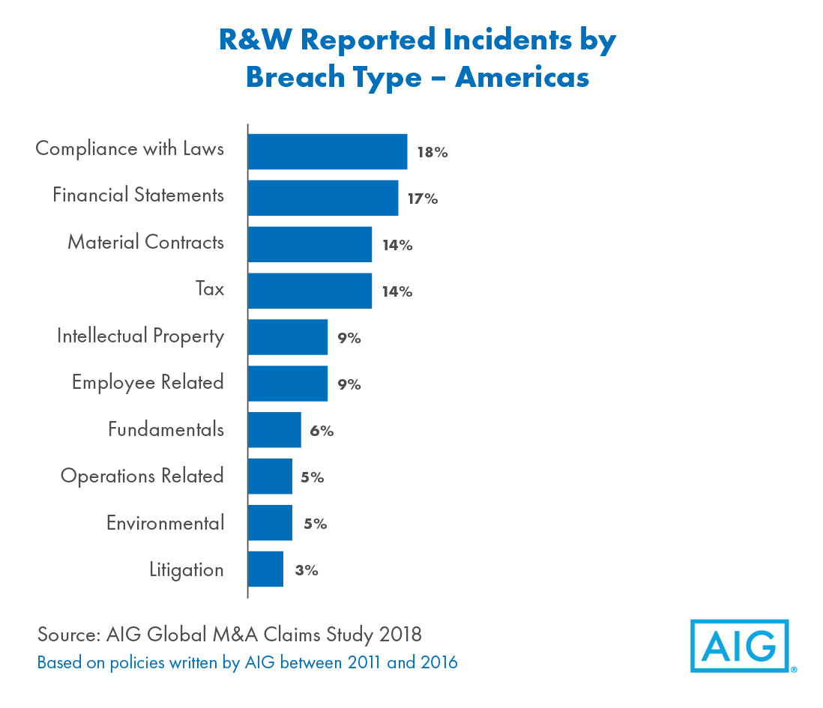
Frequently Made Claims
Representations relating to financial statements, compliance with laws, material contracts and taxes are the most frequently alleged to have been breached

Slide 15
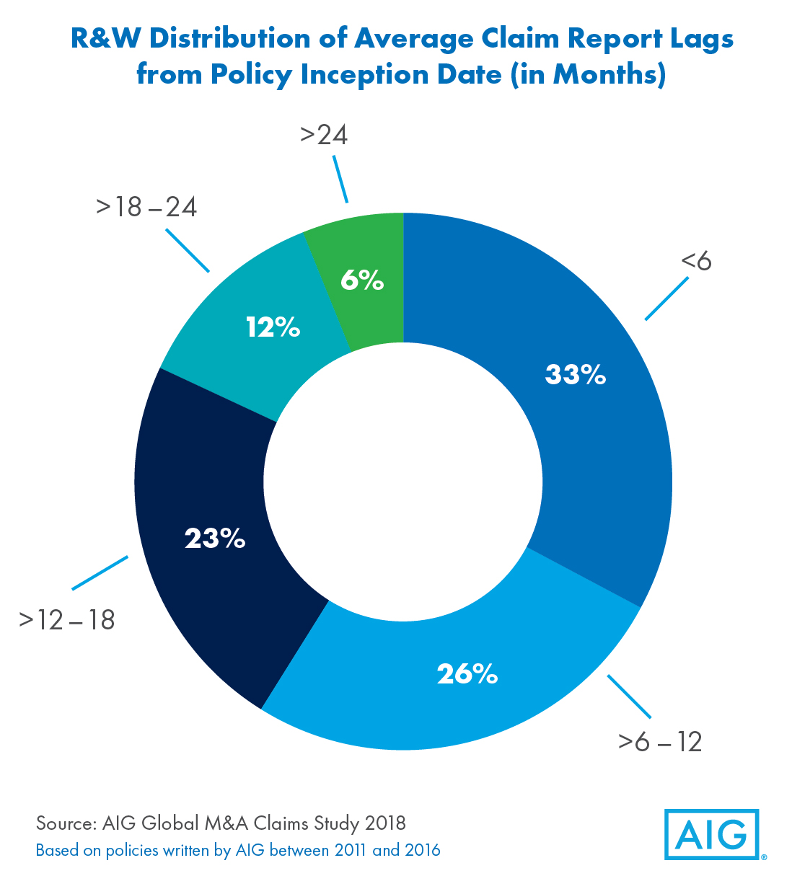
Timing of Claims
More than half of all claim notices are received within the first 12 months of the policy’s issuance

Slide 16
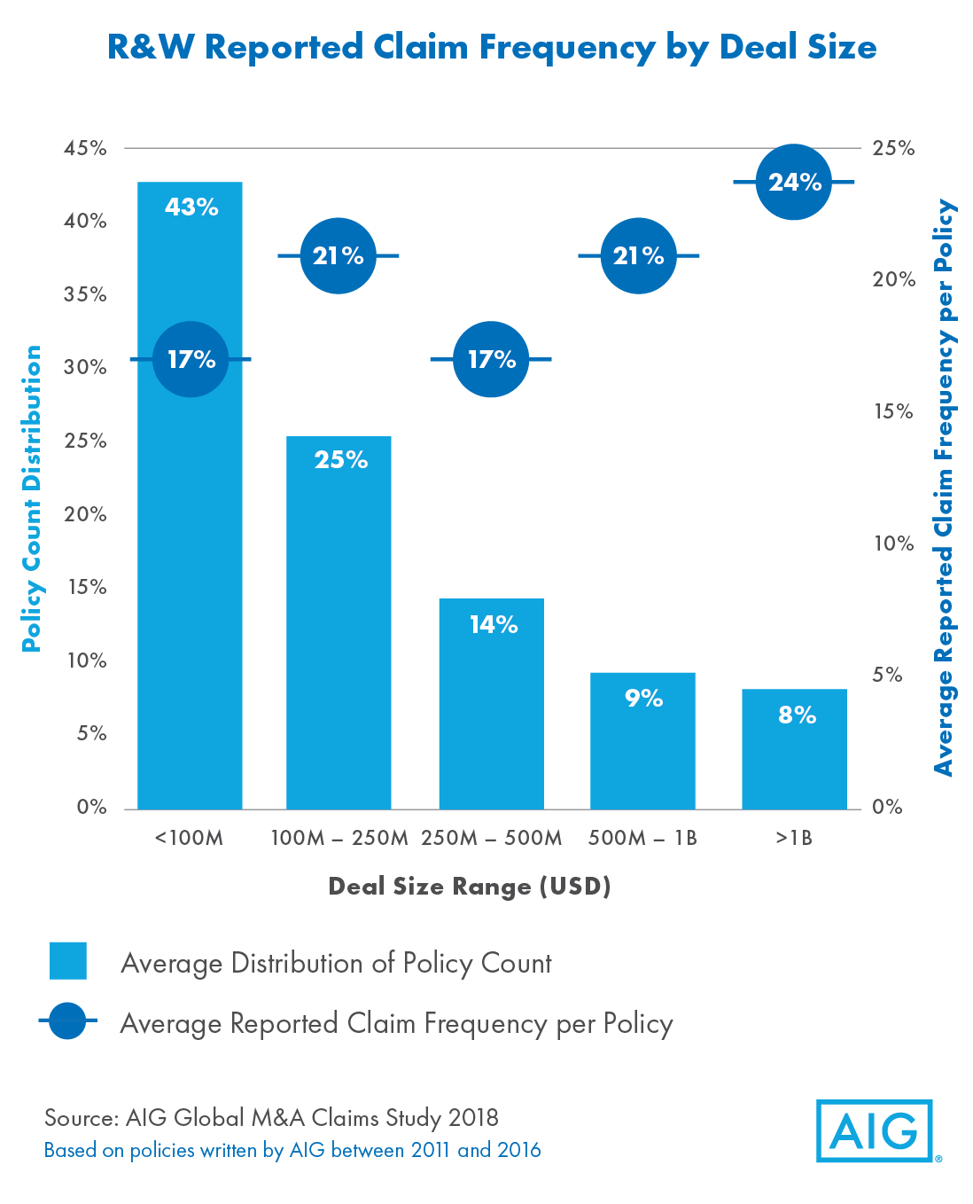
Claims Frequency by Deal Size

Slide 17
Reps & Warranties Insurance – Sample Scenario
$250M EV Transaction Without Insurance
$250M EV Transaction With Insurance
$197.5M (79%)
$197.5M (79%)
Background
Buyer: US private equity firm
Target: Distribution company
Seller: US private equity firm
Enterprise value: $250 million
Issue
Buyer wanted to differentiate its bid in a highly contested auction
Seller wanted a clean exit at closing to maximize closing date proceeds
Solution
Buyer-side reps & warranties insurance policy
Limit: $50 million
Total Cost: $1.5 million
Policy term: 3 years for general reps / 6 years for fundamental and tax reps
Buyer
assumed
risk
Buyer
assumed
risk
$25M (10%)
Additional
Seller Indemnity
$50M (20%)
R&W Insurance
Policy
Seller’s
liability
Insurer’s
liability
$25M (10%)
Escrow
$2.5M (1%)
Deductible
Buyer’s
liability
$2.5M (1%)
Retention
Can be split
between buyer
and seller

Slide 18
TAX INSURANCE

Slide 19
Tax Insurance: Overview
Coverage
Insures against the financial consequences of an intended tax treatment being disallowed by relevant tax authority in situations where:
  There is no clear precedence or guidance
  Transaction economics flowing to parties relies heavily on the tax structure such that investors and/or lenders thereto require comfort that the tax structure and benefits will be respected
  Tax authority approval (e.g., PLR) is not available or cannot be received in required time frame
  Potential downside is significant relative to transaction size and the financial model does not allow for “margin for error”
Tax Liability Insurance
Tax Opinion Insurance: Insure the conclusion of a tax opinion or filing position for a specific transaction or event
Tax Return Insurance: Insure some or all positions on a tax return of a specific taxable period
Tax Indemnity Insurance
Typically occurs in M&A context
Known tax risks and certain tax attributes are excluded from traditional R&W policy
Backstops/replaces tax indemnity in SPA
A separate tax insurance policy provides a holistic insurance solution
Common Issues
355 spin-offs
338(h)(10) elections/S-Corp issues
Debt/equity characterization
Cancellation of indebtedness
Tax free reorganizations
NOL protection
Tax credits
Successor liability
Liquidating trust status
Capital gain v. ordinary income treatment
REIT status
Notes:
_________________________________________________________
_________________________________________________________
_________________________________________________________
_________________________________________________________
_________________________________________________________
_________________________________________________________
_________________________________________________________
_________________________________________________________

Slide 20
Tax Insurance: Policy Considerations
Duration of Policy
Typically 7 years; non-cancellable
Cost and Coverage Limits
All-in costs are 3% to 5% of the policy limit (one-time payment); varies depending on facts and circumstances
Retention / Deductible
Varies based on particular risk (often limited to “Contest Costs Only”)
Definition of Covered Tax Position
Bespoke language related to specific issue
Covered Items
(a) Additional Taxes; (b) Fines and Penalties; (c) Interest; (d) Contest Costs; and (e) Tax Gross-up
Jurisdictions
US and foreign tax risks
Standard Exclusions
(a) Inconsistent filing position; (b) material misrepresentation; (c) change of law; and (d) settlement by insured without consent
Definition of Knowledge
Buyer-side M&A: generally limited to actual conscious awareness (no constructive or imputed knowledge), with no duty to inquire and the carrier having the burden of proving knowledge
Contest by Tax Authority
Insured is responsible for any contest. Underwriter must be kept informed and have the ability to comment and provide input
Settlements
Any settlement must be with the consent of the underwriter
Underwriting
Varies based on risk covered: may include statement of facts; recent draft acquisition agreement (if any); CIM (if any); tax memo/opinion or statement of facts; tax loss exposure calculation; other relevant/supporting information
Signing vs. Closing
Underwriters will typically bind coverage at signing subject to a 10% to 20% premium deposit
Notes:
_________________________________________________________
_________________________________________________________
_________________________________________________________
_________________________________________________________
_________________________________________________________
_________________________________________________________
_________________________________________________________
_________________________________________________________

Slide 21
Tax Indemnity Insurance for M&A
Provides coverage for financial losses for known tax risks that may be contested subsequent to closing
R&W insurance excludes known tax risks (i.e., tax risks identified in a buyer side tax due diligence report) and certain known tax attributes (i.e., net operating losses; tax credits)
Tax issues can occur a different levels of the transaction, for example: (a) Target historic exposures; (b) post-closing benefits expected by Buyer that may not be realized (i.e., basis step-up); (c) pre-closing restructuring that may have adverse consequences for the seller; (d) executive compensation on exit; (e) payments to Seller where Seller intends to remain with the Target group
Typical Motivations
Buyers | Sellers
Holistic insurance solution as supplement to R&W insurance Provide recourse when no seller tax indemnity Eliminate seller post-closing credit risk Lock in future tax benefits priced into purchase price Remove impediment to closing where request for relief or ruling from IRS not available prior to signing Distinguish bid in auction Protect key relationships/employees | Reduce escrows or contingencies, thereby enabling distribution of sale proceeds (and maximize IRRs) Include insurance as the sole remedy in draft agreements in auctions Attract best offers by maximizing indemnification Protect against future adverse consequences on seller from sale (i.e., steps taken to allow buyer to max tax benefits) Protect passive sellers
Notes:
_________________________________________________________
_________________________________________________________
_________________________________________________________
_________________________________________________________
_________________________________________________________
_________________________________________________________
_________________________________________________________
_________________________________________________________

Slide 22






Tax Insurance: State of the Market
Increased popularity and well-developed market
  Insurers / MGUs staffed by former tax attorneys – work on deal timeframes
  International capabilities
Insurers with tax underwriting
MGUs with tax underwriting

Slide 23
Example Transactions
Tax Indemnity Insurance: M&A
Policy for a Fortune 500 company, covering any challenge by the IRS or state that the client’s cross-border M&A transaction triggered the U.S. anti-inversion tax laws.
Policies on various S corp status issues to backstop/replace seller indemnity, providing coverage for (a) historic taxes; and (b) locking in the value of the basis-step up from 338(h)(10) election (buyer policy) or F reorg (seller policy).
Policy protecting two key employees from excise taxes due on golden parachutes (section 280G) in the context of a sale of the business and exit of the key employees.
Policy in connection with the sale of personal goodwill by the founder and sale of assets by a C-corp. The buyer sought to ensure the founder’s position was protected as the founder would remain integrally involved post-sale.
Policy protecting against a challenge by the IRS or state (under any theory) that the client’s tax-free spin-off transaction is taxable.
Various policies in connection with the sale of a REIT, covering buyer for the risk that after closing the IRS would successfully challenge the qualification of a target entity as a Real Estate Investment Trust for a pre-closing period. Typically bound as part of a REIT R&W policy.
Tax Liability Insurance
Policy for a leading global investment bank that held a concentrated tax position in renewable energy tax credits and structural risk, transferring that risk to the insurance market to allowed continued origination across all parts of the bank in this sector.
Policy for a commodity trader’s refined coal facility to lock in the value of production tax credits that was specifically excluded from the R&W policy.
Policy protecting founding US shareholders against a challenge that section 367 did not apply in the context of a corporate re-organization and re-capitalization.
Policy for a European-based multinational undertaking an internal restructuring, to manage the risk that the IRS would successfully assert that a transferred subsidiary was a “U.S. real property holding corporation” (triggering FIRPTA tax).
Policy for a leading global investment bank that reorganized its corporate structure for U.S. tax purposes, insuring the intended tax treatment of the reorganization as a whole.
Notes:
_________________________________________________________
_________________________________________________________
_________________________________________________________
_________________________________________________________
_________________________________________________________
_________________________________________________________
_________________________________________________________
_________________________________________________________

Slide 24
Tax Insurance Case Study
Background Buyer: Portfolio company of US PE firm Seller: Individual shareholders of target Target: Retail clothing company
Issue Buyer sought to make a 338(h)(10) election to take advantage of certain tax deductions it could take after the deal closed, but was concerned about potential difficulty collecting on an indemnity claim in the event the IRS challenged that “S-status” and subsequently invalidated the 338(h)(10) election
Solution Tax indemnity insurance policy provided to buyer and no indemnity from seller was required Limit: $95 million Retention: $250,000 (for contest costs only) Policy period: 7 years Insurance would respond in the event the IRS challenged the target’s “S-status,” which would invalidate buyer’s 338(h)(10) election Policy covered (a) exposure to closing for taxes that would be payable on basis of a C-corp; and (b) the present value of the future tax savings that the buyer would forfeit as a result of the election invalidation

Slide 25
Tax Insurance Case Study
Background Seller: US PE firm Buyer: US PE firm Target: Portfolio company of the seller Purchase price: ~$170 million
Issue During diligence, it was discovered that the target inadvertently failed to comply with the consent requirement for the filing of consolidated federal income tax returns from 2007 onward Target requested relief from the IRS for such inadvertent failure; however, the uncertainty as to whether the IRS would grant such relief and the expected four to six month response time created a deal point
Solution Tax insurance policy provided to buyer and no indemnity from seller was required Limit: $120 million Retention: $150,000 (for contest costs only) Policy period: 7 years Buyer utilized insurance strategically to improve its bid by not requiring an indemnity from the seller in relation to the identified tax risk

Slide 26
CONTINGENT LIABILITY INSURANCE

Slide 27
Contingent Liability Insurance
Contingent liability insurance covers “one-off” identified potential exposures that have not yet crystallized
Recent examples
  Successor liability
  Specific indemnities
  Fraudulent conveyance
  Other legal, legislative or regulatory risks
Three things necessary to insure a risk:
  Quantifiable risk
  Probability analysis
  No moral hazard
Cost, limits and deductibles vary based on the particular risk
Notes:
_________________________________________________________
_________________________________________________________
_________________________________________________________
_________________________________________________________
_________________________________________________________
_________________________________________________________
_________________________________________________________
_________________________________________________________

Slide 28
Contingent Liability Insurance Case Study
Background Sellers: 5 individuals that founded the target Buyer: US PE firm Target: Direct sales marketer of apparel business of sellers Purchase price: ~$200 million
Issue Buyer purchased 88.5% of the target (management rolling over the remaining) Purchase price funded with $100 million in debt, $80 million of which was used to pay sellers via a distribution Sellers were concerned that in the event the target was to become insolvent, the distribution could be determined to be an avoidable transfer
Solution Contingency insurance policy was purchased Limit: $50 million Retention: $250,000 (for defense costs only) Policy period: 6 years for all reps and warranties Sellers utilized insurance to limit their exposure to potential “avoidable transfer” claims

Slide 29
APPENDIX A – CONTACT INFORMATION

Slide 30
Marsh Transactional Risk Contact Information
Craig Schioppo Managing Director Marsh USA Inc. 1166 Avenue of the Americas New York, NY 10036 Office: +1 212-345-6492 Mobile: +1 917-825-0351 Email: craig.schioppo@marsh.com | Craig Warnke Managing Director Marsh USA Inc. 1166 Avenue of the Americas New York, NY 10036 Office: +1 212-345-3332 Mobile: +1 917-572-8348 Email: craig.warnke@marsh.com | Sean Crnkovich Senior Vice President Marsh USA Inc. 1166 Avenue of the Americas New York, NY 10036 Office: +1 212-345-4932 Mobile: +1 646-659-1109 Email: sean.crnkovich@marsh.com | Mark McTigue (Tax) Senior Vice President Marsh USA Inc. 1166 Avenue of the Americas New York, NY 10036 Office: +1 212-345-5635 Mobile: +1 646-283-2938 Email: mark.mctigue@marsh.com
Yem Mai Senior Vice President Marsh Risk & Insurance Services 345 California Street, 9th Floor San Francisco, CA 94104 Office: +1 415-743-8198 Mobile: +1 415-697-9227 Email: yem.mai@marsh.com | Ashley Parsa Senior Vice President Marsh USA Inc. 3560 Lenox Road Atlanta, GA 30326 Office: +1 404-995-2894 Mobile: +1 347-410-1248 Email: ashley.parsa@marsh.com | Steven Klein Senior Vice President Marsh Risk & Insurance Services 345 California Street, 9th Floor San Francisco, CA 94104 Office: +1.415.743.8412 Mobile: +1.415.260.2603 Email: steven.klein@marsh.com | Antony Joyce (Tax) Senior Vice President Marsh USA Inc. 1166 Avenue of the Americas New York, NY 10036 Office: +1 212-345-0780 Mobile: +1 347-327-2690 Email: antony.joyce@marsh.com
Jodi Rosensaft Senior Vice President Marsh USA Inc. 1166 Avenue of the Americas New York, NY 10036 Office: +1 212-345-0046 Mobile: +1 929-310-0582 Email: jodi.rosensaft@marsh.com | Ryan Sakamoto Senior Vice President Marsh Canada Limited 120 Bremner Boulevard, Suite 800 Toronto, ON M5J 0A8 Office: +1 416-349-6624 Mobile: +1 416-559-6004 Email: ryan.sakamoto@marsh.com | Mat Allen Senior Vice President Marsh USA Inc. 1717 Main Street, 43rd Floor Dallas, TX 75201 Office: +1.214.303.8643 Mobile: +1.214.862.9072 Email: matson.allen@marsh.com

Slide 31
This document and any recommendations, analysis, or advice provided by Marsh (collectively, the “Marsh Analysis”) are intended solely for the entity identified as the recipient herein (“you”). This document contains proprietary, confidential information of Marsh and may not be shared with any third party, including other insurance producers, without Marsh’s prior written consent. Any statements concerning actuarial, tax, accounting, or legal matters are based solely on our experience as insurance brokers and risk consultants and are not to be relied upon as actuarial, accounting, tax, or legal advice, for which you should consult your own professional advisors. Any modeling, analytics, or projections are subject to inherent uncertainty, and the Marsh Analysis could be materially affected if any underlying assumptions, conditions, information, or factors are inaccurate or incomplete or should change. The information contained herein is based on sources we believe reliable, but we make no representation or warranty as to its accuracy. Except as may be set forth in an agreement between you and Marsh, Marsh shall have no obligation to update the Marsh Analysis and shall have no liability to you or any other party with regard to the Marsh Analysis or to any services provided by a third party to you or Marsh. Marsh makes no representation or warranty concerning the application of policy wordings or the financial condition or solvency of insurers or reinsurers. Marsh makes no assurances regarding the availability, cost, or terms of insurance coverage.
MA13-12658
Copyright © 2019 Marsh Inc. All rights reserved

